Slide 1


NEXT GEN EMPLOYABILITY PROGRAM
CREATING A FUTURE-READY WORKFORCE
Student Name :
Jayesh Varunkar
Student ID :
College Name :
STU6732fa07ef1061731394055
AISSMS IOIT,Pune

Slide 2
CAPSTONE PROJECT SHOWCASE
Project Title
Taza Khabar
Abstract | Problem Statement | Project Overview | Proposed Solution | Technology Used | Modelling & Results | Conclusion | Q&A

Slide 3
Abstract
1
The platform offers a seamless registration and login system, ensuring secure access for users. Personalized accounts allow user to save preferences for topics of interest.
2
Users can explore news across various topics such as politics, sports, technology, entertainment, and more. Each topic is curated to ensure timely updates and comprehensive coverage.
3
Each news snippet provides a concise summary and a direct link to the original source. Clicking on the headline redirects users to the full article, maintaining authenticity and source credibility
4
A user-friendly interface designed to work seamlessly across devices, ensuring smooth navigation, quick searches, and an engaging news-browsing experience.

Slide 4


Problem Statement
In today's fast-paced digital world, users often struggle to access timely and accurate news tailored to their interests. The lack of a centralized platform offering secure, personalized access to diverse news topics further complicates the issue. Additionally, navigating through multiple websites to access original news sources can be cumbersome and time-consuming.
Taza Khabar aims to address these challenges by providing a user-friendly web application that enables users to securely register, log in, and explore news from various categories. The platform ensures easy navigation to original sources, delivering a seamless and reliable news consumption experience.

Slide 5

Project Overview
Purpose: A modern news aggregation platform that provides users with access to diverse news topics in a secure and user-friendly manner.
Features:
User registration and login for personalized experiences.
Categorized news updates across topics like politics, sports, and technology.
Direct redirection to original articles for credible and detailed information. Responsive and intuitive design for seamless use on all devices.
Goal: To offer a reliable, fast, and personalized way for users to stay informed without navigating multiple platforms.

Slide 6
Proposed Solution
To address the challenges of efficient news consumption, Taza Khabar will provide a centralized, user-friendly platform with the following solutions:
Secure User Authentication System:
Implement a robust registration and login mechanism using encryption techniques to ensure user data security.
Allow users to personalize their experience by selecting preferred news topics.
Categorized News Aggregation:
Aggregate news from reliable sources and categorize it into topics like politics, sports, technology, and entertainment.
Ensure real-time updates for the latest news coverage.
Seamless Redirect to Original Sources:
Display concise news summaries with links to the original articles.
Provide a clean and transparent way for users to access detailed information directly from the source.

Slide 7
Technology used
Frontend:
React js
Bootstrap
CSS
Backend:
Node js
Express js
Database:
MongoDB

Slide 8
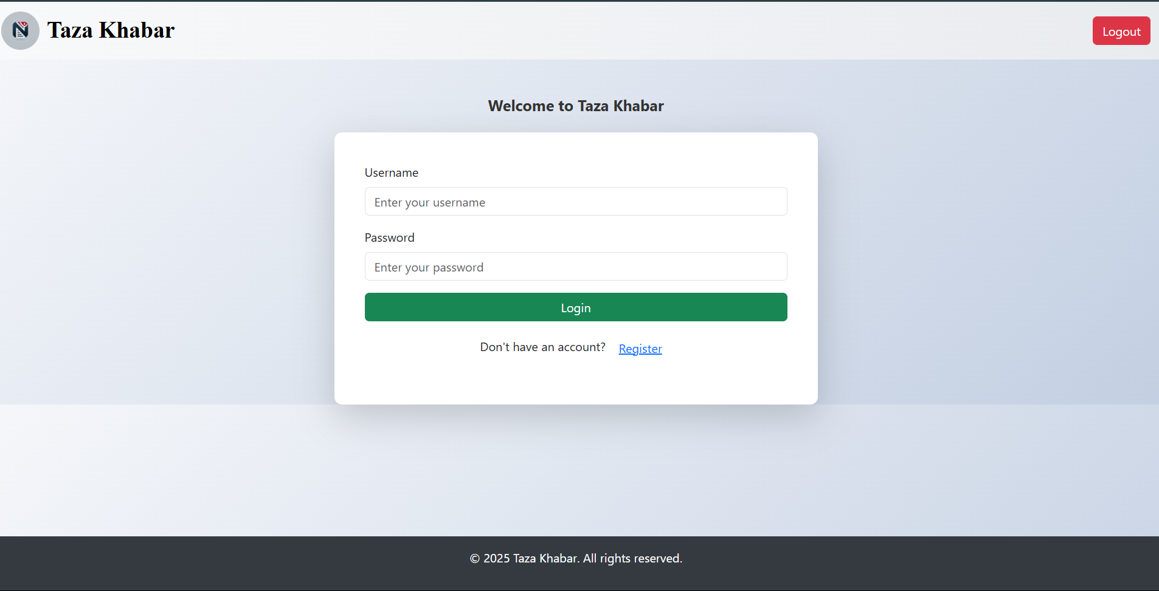
Modelling & Result

Slide 9
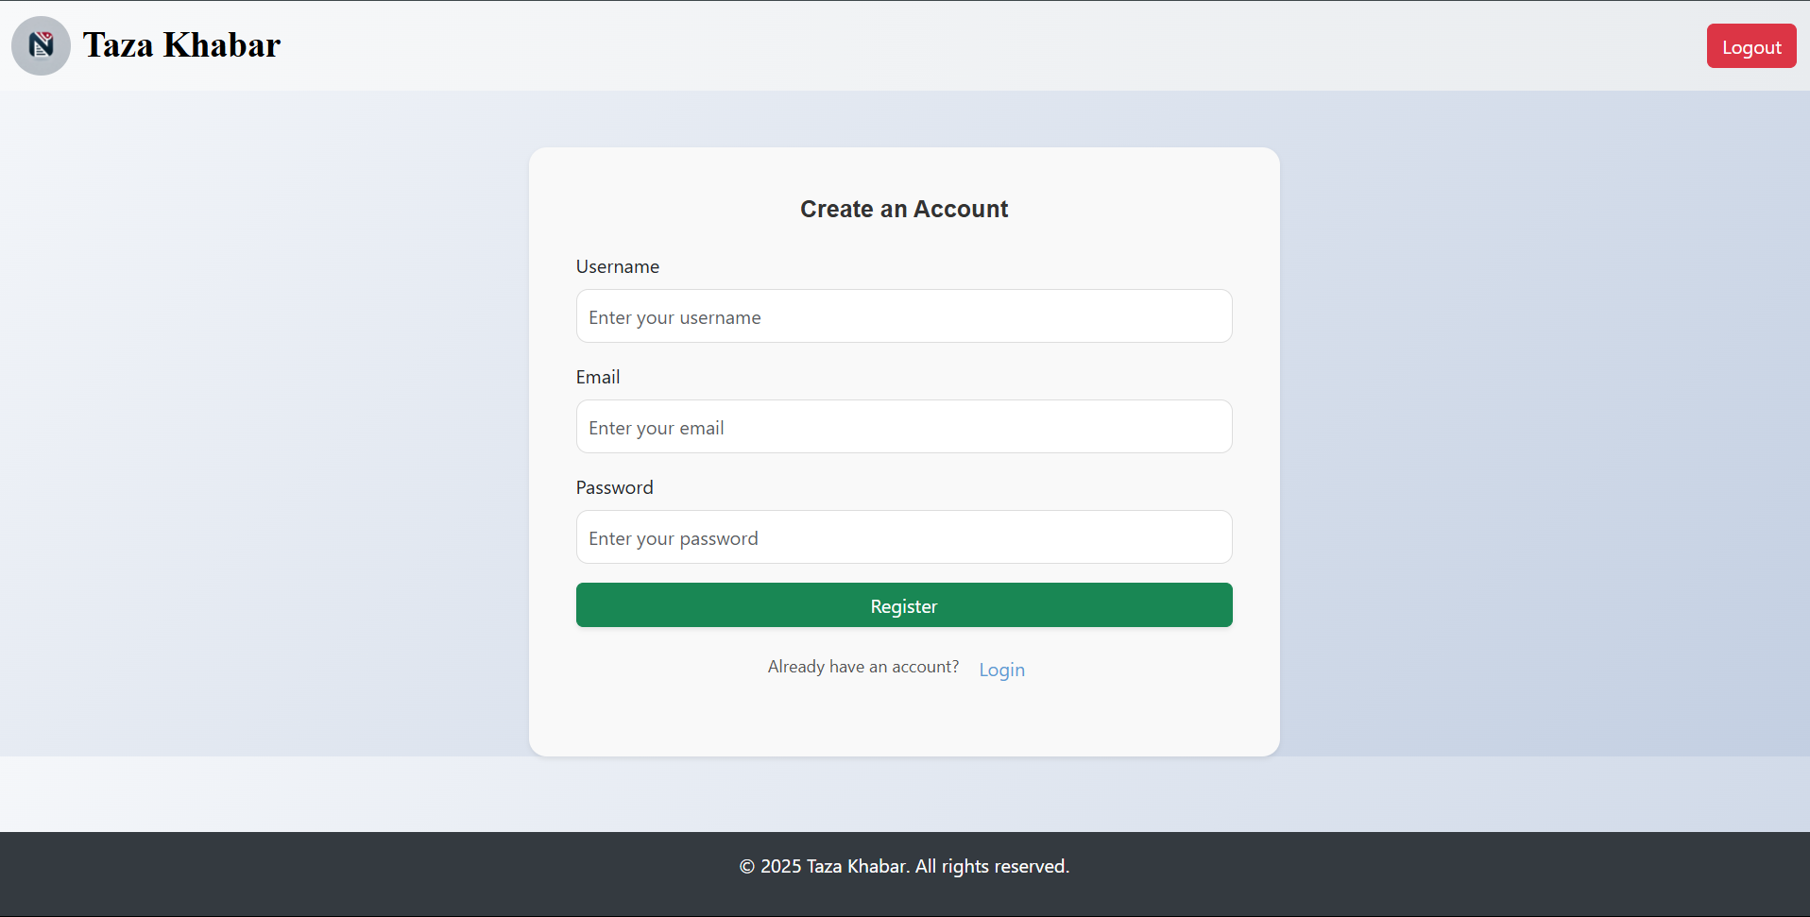
Modelling & Result

Slide 10
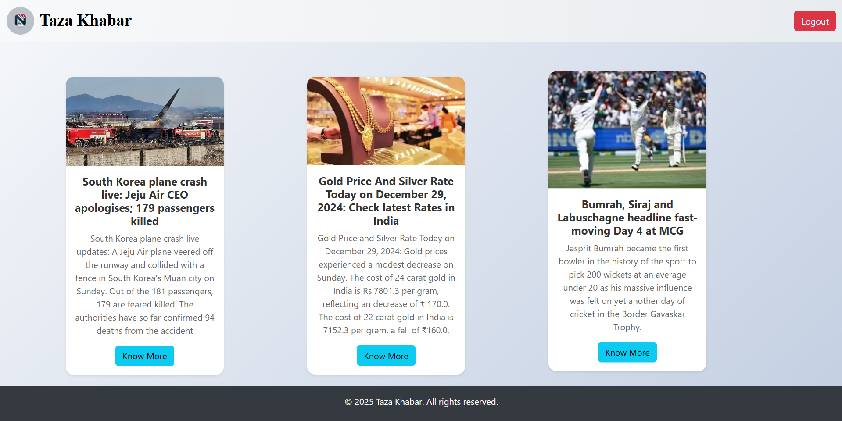
Modelling & Result

Slide 11

Conclusion
Taza Khabar aims to revolutionize the way users access news by providing a secure, reliable, and user-friendly platform.
With categorized news aggregation, seamless redirection to credible sources, and an intuitive design, the project addresses the need for efficient and personalized news consumption.
By ensuring accessibility across devices and scalability for future growth, Taza Khabar is set to become a trusted destination for staying informed in today's fast-paced world.

Slide 12


Notes:
Thank You !!

